Slide 1




UTILIZING BINAURAL BEATS TO COMBAT MENTAL FATIGUE IN CORPORATE EMPLOYEES FOR ENHANCED COGNITIVE PERFORMANCE AND SUSTAINED PRODUCTIVITY
Md. Jubairul Alam*, Md. Mortuza Ahmmed
*Bachelor of Science, Department of Computer Science, American International University-Bangladesh, Dhaka, Bangladesh
Associate Professor, Department of Mathematics, American International University-Bangladesh, Dhaka, Bangladesh
3rd International Conference on Advancement of Life Sciences (ICALS 2025)

Slide 2
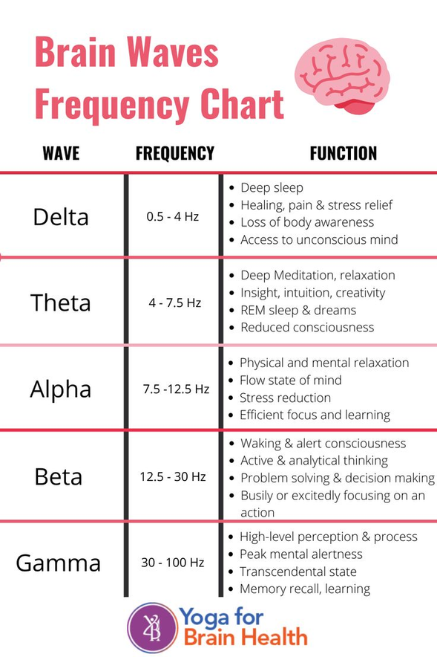
INTRODUCTION & BACKGROUND
Mental fatigue and sleep deprivation are significant challenges in corporate environments, leading to cognitive impairment, reduced productivity, and health issues. This study investigates the application of binaural beats—non-invasive auditory stimuli—as a tool to mitigate mental fatigue and enhance workplace productivity. Participants were divided into experimental and control groups, with the experimental group exposed to beta, alpha, and theta wave frequencies. Over four weeks, cognitive performance, stress levels, and productivity metrics were measured. Results showed that binaural beats significantly improved attention span, memory recall, sleep quality, and task efficiency while reducing fatigue and perceived stress. These findings highlight the potential of binaural beats as an effective intervention for workplace wellness programs.
Figure: Brain waves charts description[]

Slide 3
RESEARCH OBJECTIVE
The study aims to explore how binaural beats, specifically beta (13–30 Hz), alpha (8–12 Hz), and theta (4–8 Hz) frequencies, impact mental fatigue and cognitive performance in corporate employees

Slide 4
LITERATURE REVIEW
Mental Fatigue and Workplace Productivity: Studies show that prolonged work and stress contribute to cognitive decline and decreased efficiency[1]. Fatigue is linked to errors, reduced focus, and poor decision-making.
Brainwave Entrainment with Binaural Beats: Previous research indicates that binaural beats may help in modulating mood and cognitive functions[2]. For instance, beta waves are associated with focus and alertness, while alpha waves promote relaxation and theta waves enhance creativity and sleep[3].
Applications in Cognitive Enhancement: Binaural beats have been used in educational, therapeutic, and personal productivity contexts. Evidence suggests that these auditory stimuli can improve attention span and reduce stress levels.
Gaps in the Literature: While many studies validate the cognitive benefits of binaural beats, limited research focuses specifically on corporate employees and their sustained effects on productivity[4].

Slide 5
METHODOLOGY
Study Design
The study employed a randomized controlled design over four weeks. Participants were divided into two groups:
After Experiment: Exposed to binaural beats during work and relaxation.
Before Experiment: Worked under similar conditions but without binaural beats.
Participants
A total of 48 corporate employees aged 18–35 from various industries were selected. Equal distribution of gender and job roles was ensured.
Intervention
Beta Waves: Played during work sessions to improve focus and attention.
Alpha Waves: Administered during breaks to promote relaxation.
Theta Waves: Played before bedtime to enhance sleep quality.
Data Collection
Primary Data & Secondary Data
Statistical Analysis by Correlation Matrix & Heatmap
STUDY DESIGN
PARTICIPANTS
INTERVENTION
DATA COLLECTION

Slide 6
DATA COLLECTION CATAGORY
SLEEP HABIT
MENTAL HABITS
PERFORMANCE
CREATIVITY
OVERALL WELL-BEING

Slide 7
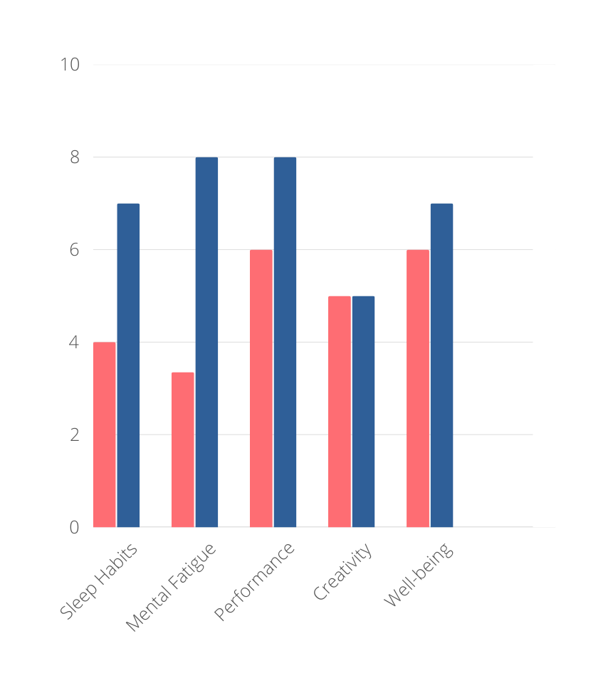
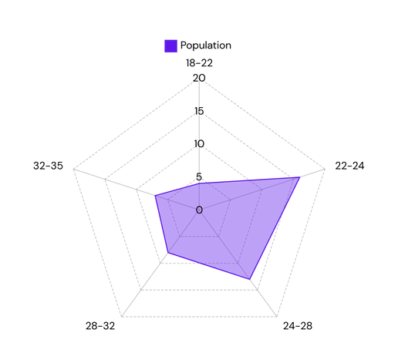
RESULT & FINDINGS
A Comparative Analysis
01 - BEFORE EXPERIMENT
02 - AFTER EXPERIMENT
Figure 2: Age Rader Chart
Figure 3: Comparative Mean Scoring from Both Cases

Slide 8
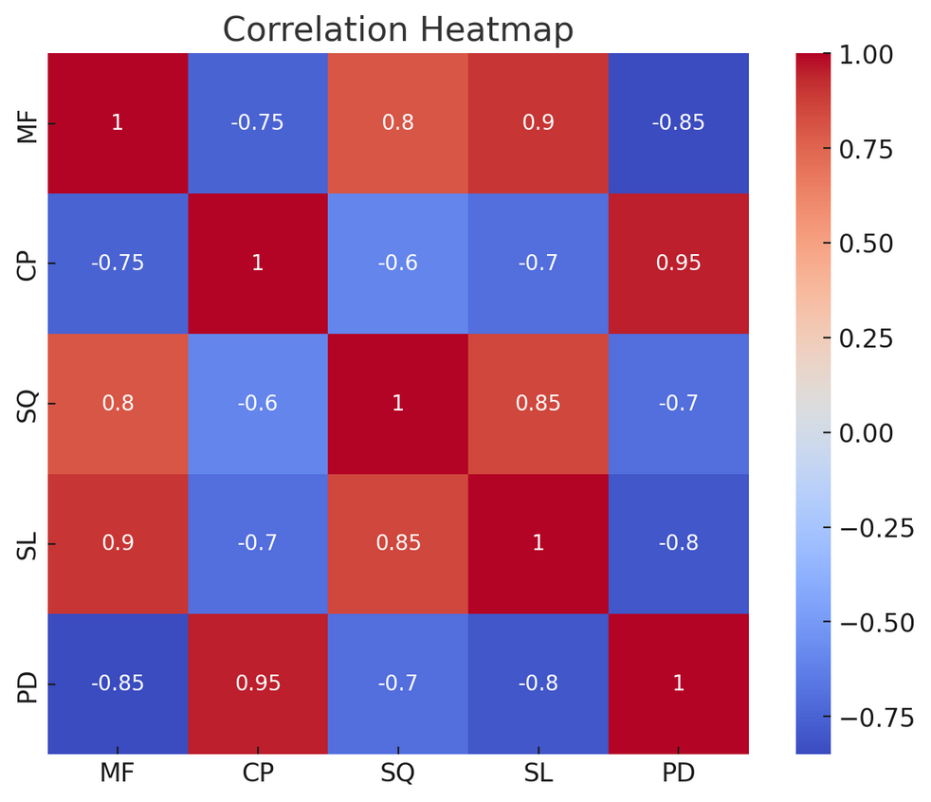
RESULT & FINDINGS
Statistical Analysis
Variable | MF | CP | SQ | SL | PD
MF | 1 | -0.75 | 0.80 | 0.90 | -0.85
CP | -0.75 | 1 | -0.60 | -0.70 | 0.95
SQ | 0.80 | -0.60 | 1 | 0.85 | -0.70
SL | 0.90 | -0.70 | 0.85 | 1 | -0.80
PD | -0.85 | 0.95 | -0.70 | -0.80 | 1

Slide 9
LIMITATIONS
Subjectivity of Self-Reports
Sample Size
Duration of Study
Individual Variability
Technological Variability

Slide 10
FUTURE STUDY
Long-term effects of binaural beats
Their efficacy in high-stress occupations, such as healthcare and IT
Neural mechanisms underlying observed effects using EEG or fMRI

Slide 11
CONCLUSION
This study highlights the effectiveness of binaural beats as a tool to mitigate mental fatigue and enhance cognitive performance in corporate employees. By integrating binaural beats into workplace wellness strategies, organizations can improve employee well-being and productivity.
Reference
[1] T. J. Balkin et al., “Cognitive fatigue and its impact on workplace performance,” J. Occup. Health Psychol., vol. 7, no. 1, pp. 16–32, 2002.
[2] L. S. Colzato et al., “Binaural beats enhance attention and meditation,” Cogn. Res. Princ. Implic., vol. 2, no. 1, pp. 1–7, 2017.
[3] J. D. Lane et al., “Binaural auditory beats affect vigilance performance and mood,” Physiol. Behav., vol. 63, no. 2, pp. 249–252, 1998.
[4] G. Oster, “Auditory beats in the brain,” Sci. Am., vol. 229, no. 4, pp. 94–102, 1973.
[5] T. Weiland et al., “The effects of binaural beats on working memory performance in healthy adults,” Aust. J. Psychol., vol. 63, no. 4, pp. 207–214, 2011.

Slide 12
THANK YOU
3rd International Conference on Advancement of Life Sciences (ICALS 2025)

